Slide 1
Authentication & Authorization

Slide 2
Agenda
Common requirements on Web application security
How to protect resources on your MVC project
How to implement Authentication and Authorization
What are the most common web-app vulnerabilities?
OWASP
Practical Example: SQL Injection (SQLi) on a .NET application
Practical Example: Cross-Site Scripting (XSS) on a .NET application
2
© 2017 by kariera.gr

Slide 3
Common requirements on Web application security
Usually we have different roles on our web application. For example, in our e-shop we will have two roles: Customer, Administrator
Customer should be able to login, order items and view order history.
Administrator should be able to login and manage Products, Orders and other e-shop parameters.
Customers SHOULD NOT be able to access Pages related to e-shop administration.
Customers SHOULD NOT be able to impersonate another Customer and order items or view other Customer’s order history.
3
© 2021 by kariera.gr

Slide 4
Authentication vs Authorization
Authentication is the process which allows the user to provide credentials and these credentials are compared to those stored in an operating system, database or other resource. If the credentials provided match with the credentials already stored, user authenticates successfully and can perform actions in the system.
Authorization refers to the to the process that determines what the user can do in the system (what resources is allowed to access, what actions to perform etc.)
4
© 2021 by kariera.gr

Slide 5
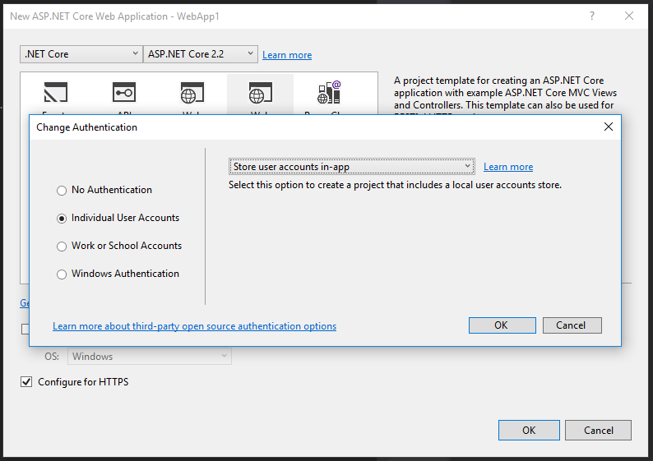
How to Implement Authentication
When creating your Web Application Project (MVC), make sure that you change the “Authentication” option to Individual User Accounts…
In order to configure Identity Services option, you must add code in the ConfigureServices method of file Startup.cs
On package manager console run: Update-Database to create the DB tables.
5
© 2021 by kariera.gr

Slide 6
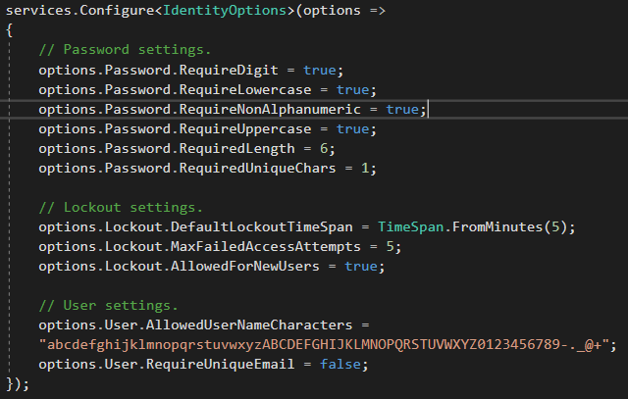

How to Implement Authentication (continued…)
Also, in the ConfigureServices method of Startup.cs file, you must have the following line:
And in Configure method of Startup.cs file, you must have the following line:
You use the services.Configure for the IdentityOptions �
6
© 2021 by kariera.gr

Slide 7
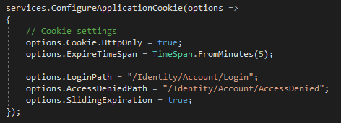
Injection of Identity classes on pages…
In order to configure the default Login page and Access Denied page when user is not authorized, you do that in the Startup class on Configure Services…
You inject the SignInManager and UserManager services in a page with the @inject attribute:
@using Microsoft.AspNetCore.Identity
@inject SignInManager<IdentityUser> SignInManager
@inject UserManager<IdentityUser> UserManager
Similarly, you inject these services in a controller’s constructor.
7
© 2021 by kariera.gr

Slide 8
How to customize the Identity User Object
You create a new model class that extends the IdentityUser � public class WebApp1User : IdentityUser
You add properties in the model class and decorate them with the [PersonalData] attribute (for GDPR compliance).
[PersonalData]
public string Name { get; set; }
[PersonalData]
public DateTime DOB { get; set; }
You modify your ApplicationDbContext to extend from IdentityDbContext<WebApp1User>
In package manager you execute: Add-Migration CustomUserData and Update-Database
ATTENTION: Now, when injecting UserManager and SignInManager you should not use the <IdentityUser> as generic but your new <WebApp1User> class (in order to have new properties available)
You have to update the Register pages and controller
8
© 2021 by kariera.gr

Slide 9
How to customize IdentityRole and change Primary Key Type
To customize the base IdentityRole classs, you can create a new class and extend the IdentityRole (similarly to the IdentityUser customization example)
If changing the IdentityRole and/or Primary Key, the ApplicationDbContext class should be updated like:
public class ApplicationDbContext : IdentityDbContext<IdentityUser<Guid>, IdentityRole<Guid>, Guid> {
public ApplicationDbContext(DbContextOptions<ApplicationDbContext> options) : base(options) {
}
}
However, changing the primary key involves dropping and re-creating the table:
PMC � Drop-Database
PMC � Remove-Migration
9
© 2021 by kariera.gr

Slide 10
Google authentication
Go to https://developers.google.com/identity/sign-in/web/sign-in#before_you_begin and click on CONFIGURE A PROJECT.
In the wizard, enter a project and product name and select Calling from a Web Server. Enter the following URL: https://localhost:<<Your project port>>/signin-google � Copy the Client ID and Client Secret on a notepad
In the Startup class, in the ConfigureServices method, add the following:
services.AddAuthentication().AddGoogle(googleOptions =>
{
googleOptions.ClientId = "<<your google client id>>";
googleOptions.ClientSecret = "<< your google client secret>>";
}
);
On the Login page, next to the local account login area, a new area appears with the Google service login button.
Similarly you can enable Facebook, Twitter or any other provider. Check documentation at: https://docs.microsoft.com/en-us/aspnet/core/security/authentication/social/?view=aspnetcore-2.2&tabs=visual-studio
10
© 2021 by kariera.gr

Slide 11
How to Scaffold identity and customize login, register etc.
When you create a new ASP.NET Core MVC project, and add authentication, you already have register and login pages available as they are part of the Microsoft.AspNetCore.Identity.UI Nuget package.
In order to add customizable pages, right-click on your project and select Add > New Scaffolded Item and on the left page select “Identity” and click Add.
You need to have installed the CodeGeneration Nuget packages
In the next page you can select which Identity pages you need to override. For example you can select Login, Register and Change Password pages.
Select the appropriate DataContext class and click Add…
You will see new cshtml files generated under folder: Areas/Identity/Pages/Account as well as under folder Views/Shared. Also a ScaffoldingReadme.txt file is generated to provide additional instructions.
10
Notes:
<number>

Slide 12
Authorization (Simple & Role-based)
If you want to apply Authorization on a Controller, place the [Authorize] attribute above Controller class.
If you want to apply Authorization on a Controller’s action, place the [Authorize] attribute above Action method.
You can also use the [AllowAnonymous] attribute to specify actions inside a Controller that can be called without authorization (in case the whole controller requires authorization).
You can Authorize a controller or an action against specific roles in your application by placing attributes like:
[Authorize(Roles = "Administrator")]
[Authorize(Roles = "HRManager,Finance")]
12
© 2021 by kariera.gr

Slide 13
Authorization (Add role services to your app)
Add the Role services to Identity: On ConfigureServices method, add:
services.AddDefaultIdentity<IdentityUser>()
.AddRoles<IdentityRole>() // sequence matters here!!!
.AddEntityFrameworkStores<ApplicationDbContext>();
In order to require all users to be authenticated (regardless of the Authorize attribute), add the following:
services.AddMvc(config =>
{ var policy = new AuthorizationPolicyBuilder().RequireAuthenticatedUser().Build();
config.Filters.Add(new AuthorizeFilter(policy));
});
You can still apply [AllowAnonymous] attribute on a Controller or a PageModel
13
© 2021 by kariera.gr

Slide 14
Authorization (Relate a user with one or more roles)
IdentityResult ir1 = roleManager.CreateAsync(new IdentityRole(role));
var user = await userManager.FindByIdAsync(uid);
IdentityResult ir2 = userManager.AddToRoleAsync(user, role);
14
© 2021 by kariera.gr

Slide 15
Add authorization handlers (e.g. verify that user owns the data) / Resource Based Authorization
To check if a specific operation is allowed on a specific record (for example a view operation for an order record) you must create a class that extends AuthorizationHandler<TRequirement,TResource>
You override this method: protected override Task HandleRequirementAsync (AuthorizationHandlerContext context, TRequirement requirement, TResource resource);
In this method you make the appropriate checks and if method succeeds you call context.Succeed(requirement)
If method fails you can call context.Fail() to explicitly fail or just return Task.CompletedTask � Task.CompletedTask doesn’t indicate fail or success – it allows for other Authorization handlers to run…
You can (and should) use Dependency Injection to inject classes as the UserManager or RoleManager.
In order for the authorization handlers to be available to Controllers via Dependency injection, they must be registered in services (on ConfigureServices method of Startup.cs file)
We must also inject the IAuthorizationService to our Controllers or Page Models / Views
15
© 2021 by kariera.gr

Slide 16
Verify Authorization action against specific operations
Usually, we have to verify an action against a specific operation. For example, for a database record we have Create, Read, Update, Delete (CRUD). We register these operations by creating a requirements class like the following:
public static class ContactOperations
{ // Operation Authorization Requirements just contain a name!!!
public static OperationAuthorizationRequirement Create = new OperationAuthorizationRequirement {Name=Constants.CreateOperationName};
public static OperationAuthorizationRequirement Read = new OperationAuthorizationRequirement {Name=Constants.ReadOperationName};
public static OperationAuthorizationRequirement Update = new OperationAuthorizationRequirement {Name=Constants.UpdateOperationName};
public static OperationAuthorizationRequirement Delete = new OperationAuthorizationRequirement {Name=Constants.DeleteOperationName};
public static OperationAuthorizationRequirement Approve = new OperationAuthorizationRequirement {Name=Constants.ApproveOperationName};
public static OperationAuthorizationRequirement Reject = new OperationAuthorizationRequirement {Name=Constants.RejectOperationName};
}
16
© 2021 by kariera.gr

Slide 17
Common web-app vulnerabilities (OWASP Top 10 – 2017)
Injection (SQL, NoSQL, LDAP etc.): untrusted data is sent to an interpreter as part of a command or query
Broken authentication: incorrect implementation of functions handling authentication & session management
Sensitive Data Exposure: Compromise of sensitive data (financial, healthcare etc.) through unprotected APIs
XML External Entities (XXE): Incorrect evaluation of external references within XML documents. Older or poorly configured XML processors may execute XML external entity references which include remote code execution
Broken Access Control: Incorrect implementation of user restrictions within the application. Exploitation can lead to a user accessing application areas that should be accessed by admins, records of other users, sensitive data etc.
Security Misconfiguration: Missing security hardening, leaving default passwords, enabling unnecessary features etc.
Cross-site scripting (XSS): A successful attack can allow the attacker to execute arbitrary HTML and JavaScript in the victim’s browser
<number>
© 2021 by kariera.gr

Slide 18
Open Web Application Security Project (OWASP)
.NET Reference: https://github.com/OWASP/CheatSheetSeries/blob/master/cheatsheets/DotNet_Security_Cheat_Sheet.md
Online community to help you secure your application.
Provides documentation, methodologies and tools for web application security.
OWASP regularly publishes the Top-Ten list which includes the top-ten most critical web application security risks. You can find the latest here: https://www.owasp.org/images/7/72/OWASP_Top_10-2017_%28en%29.pdf.pdf
You can find many security tools here: https://www.owasp.org/index.php/Category:OWASP_Download
<number>
© 2021 by kariera.gr

Slide 19
THANK YOU

